Slide 1

Git Hub
Presented by : Asif Ahmed

Slide 2

Why Git exits?

Slide 3

How Git is Different?

Slide 4
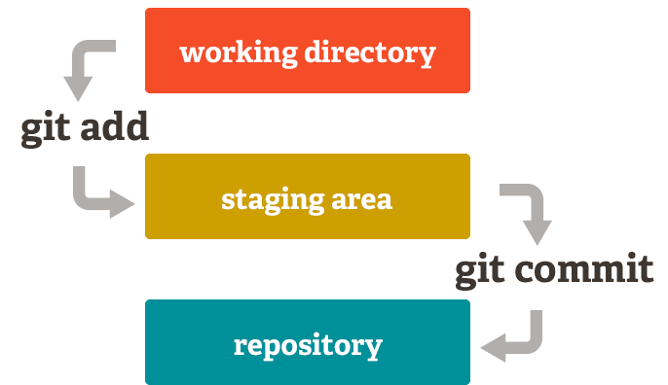
The 3 tree Architecture:

Slide 5
Storing Versions:
Stores data as snapshots.
Naming the file accurately.
Acknowledge that there is always one
project.

Slide 6

Different between Git and GitHub

Slide 7
How github works?

Slide 8
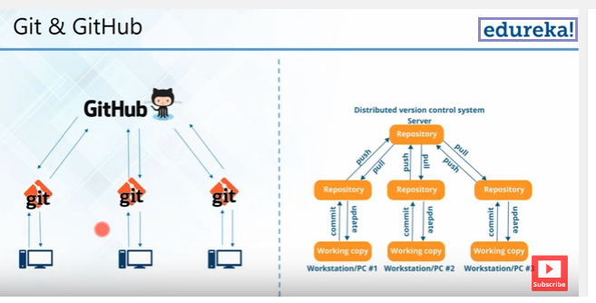

Slide 9
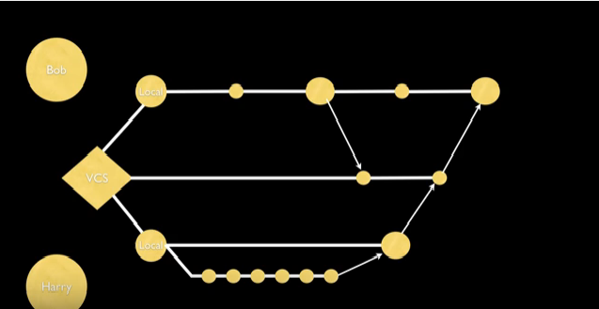

Slide 10
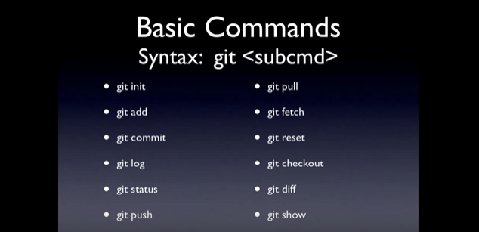

Slide 11
Questions?

Slide 12
Thank you

